Slide 1

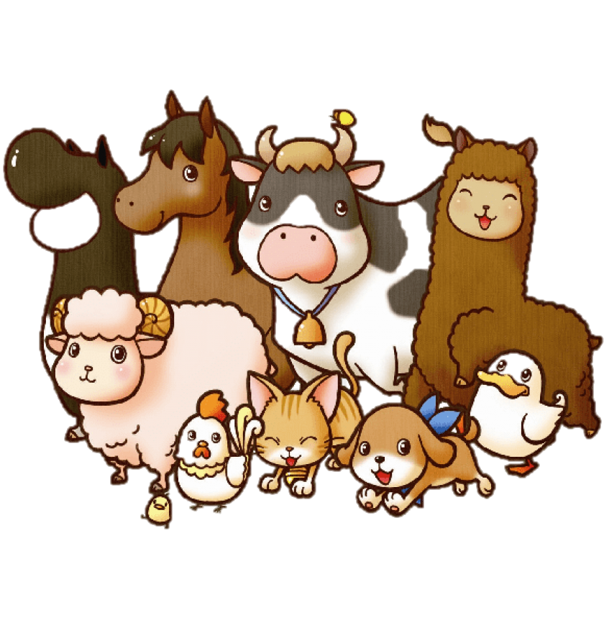

AGRICULTURAL ANIMAL BIOTECHNOLOGY
Team - 06
Batch 6
Faculty of Humanities and Sciences

Slide 2

TEAM # 6
HASANIKA | HS21907784
JANEESHA | HS21906930
RUWANI | HS21908460
THARUSHI | HS21910036
KAUSHALYA | HS21908538
CHIAKI | HS21909382

Slide 3
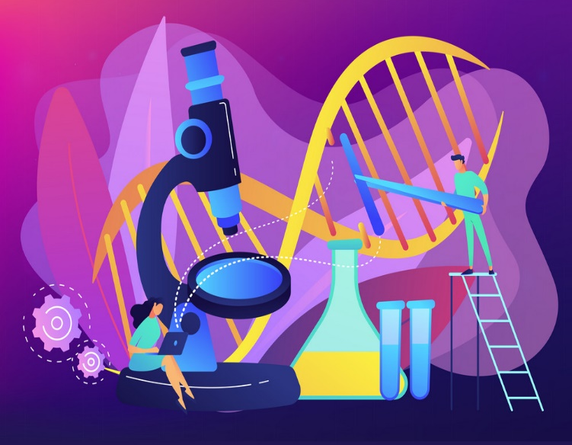
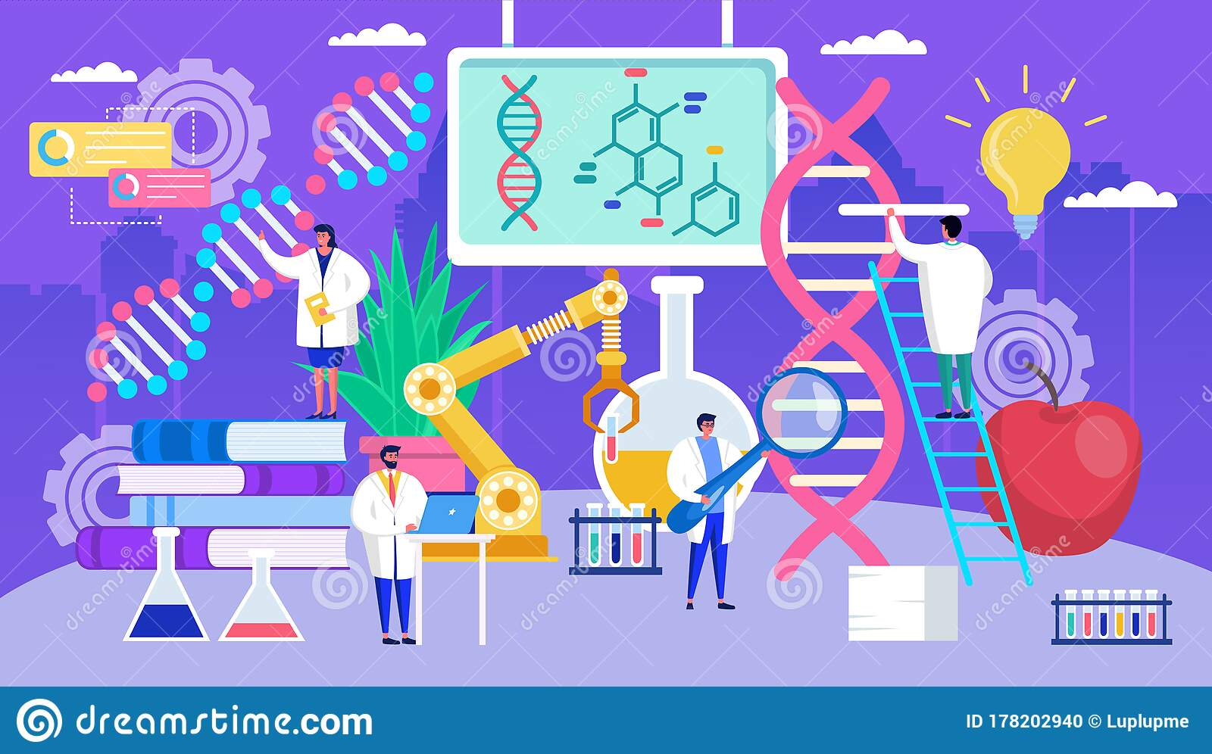
WHAT IS BIOTECHNOLOGY
In Biotechnology living organisms are used to make useful chemicals and products to perform an industrial task .
Agricultural Biotechnology
2. Medical Biotechnology
3. Food Biotechnology
4. Environmental Biotechnology
5. Marine Biotechnology
Plant
Animal

Slide 4
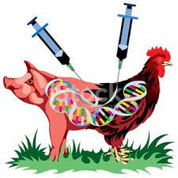
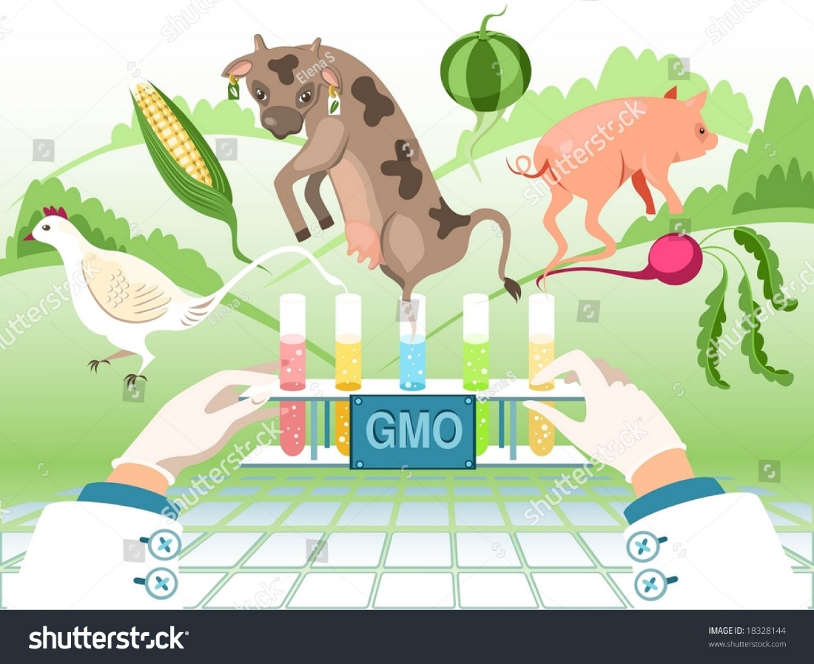
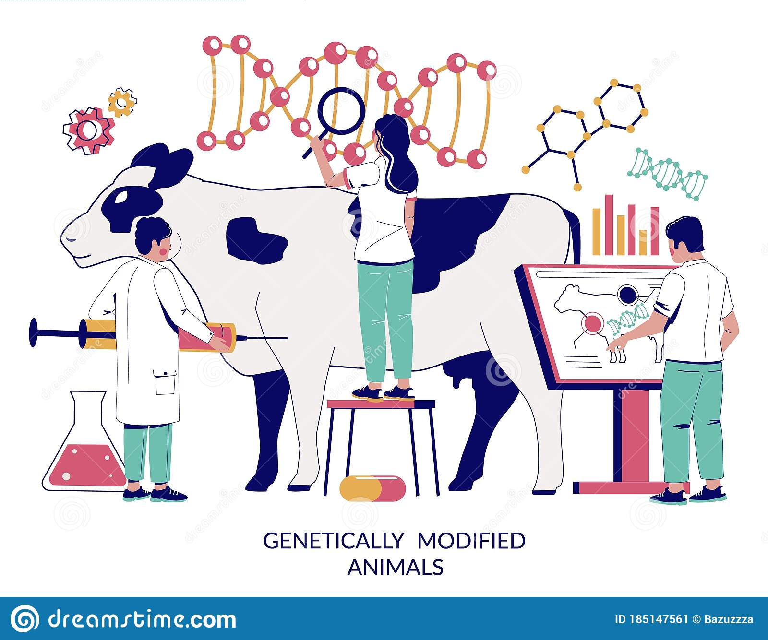
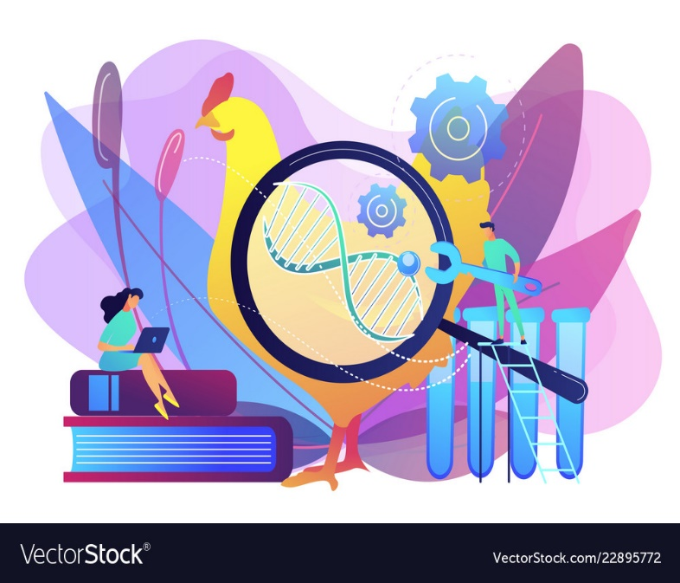
AGRICULTURAL ANIMAL BIOTECHNOLOGY
Animal biotechnology use to produce genetically modified animals that synthesize therapeutic proteins, have improved growth rates or resistant to disease. in order to improve their suitability for agriculture, industrial, or pharmaceutical applications. (National Research Council and others, 2002)

Slide 5
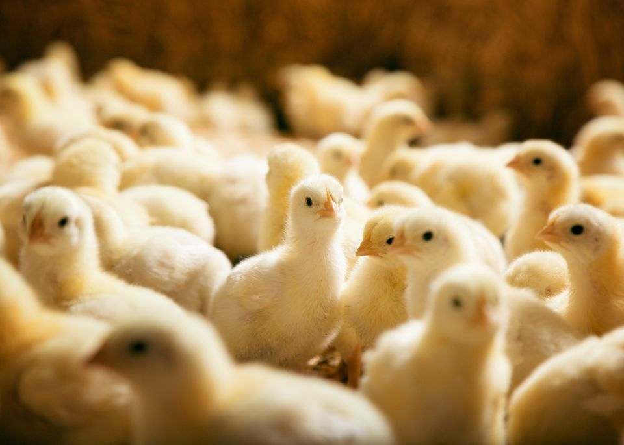
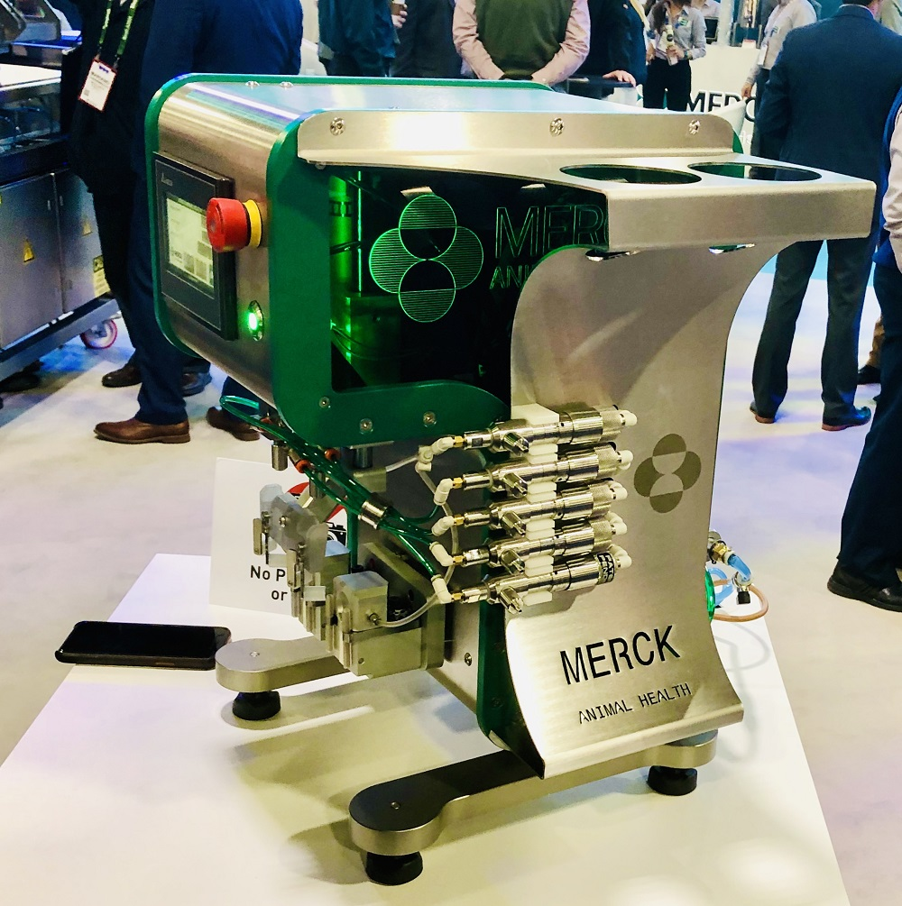
How was the Global Animal Biotechnology Market created ?
INNOJECT PRO MACHINE
What are the reasons for the Global Biotechnology Market to grow rapidly around the world ?

Slide 6
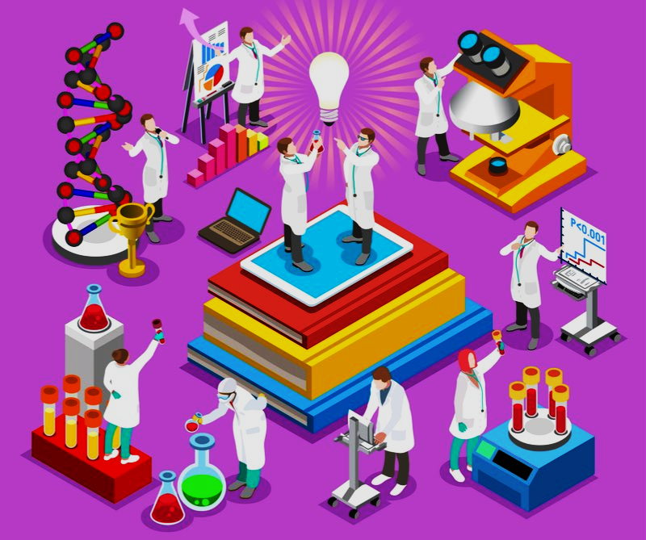
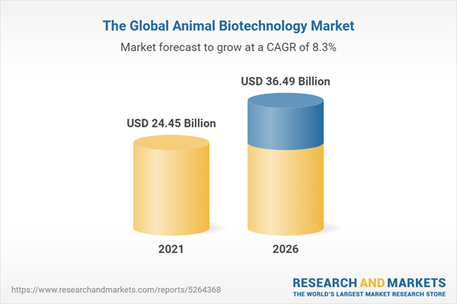
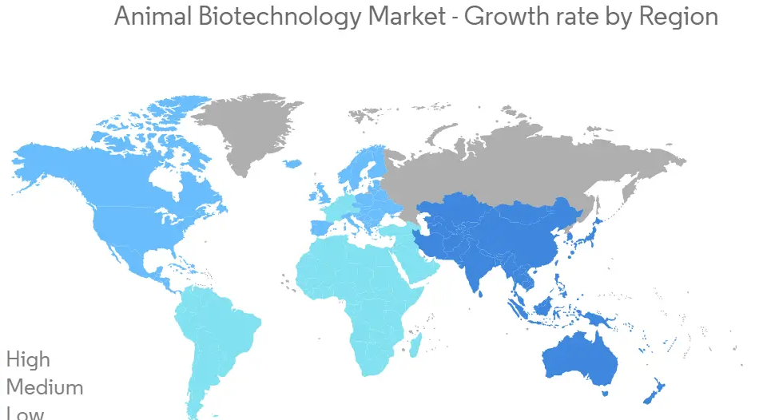
The Global Animal Biotechnology Market
What is the world rapidly growing animal biotechnology region ?
HIGH
MEDIUM
LOW

Slide 7
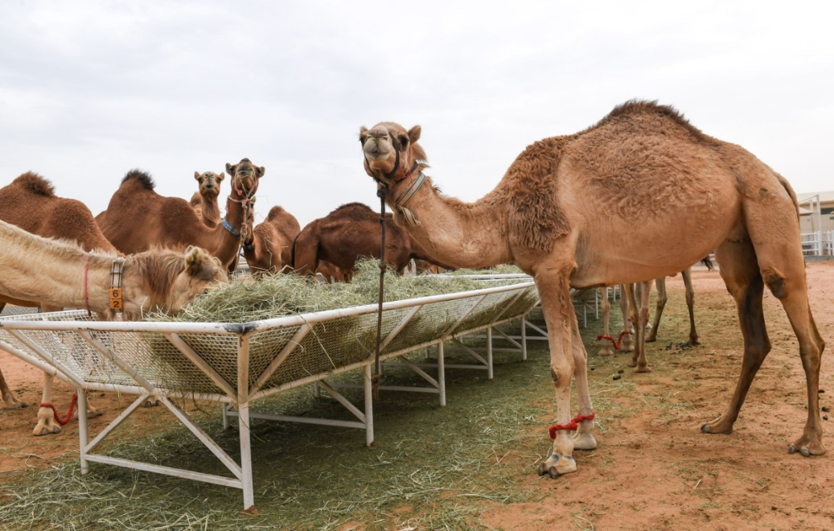
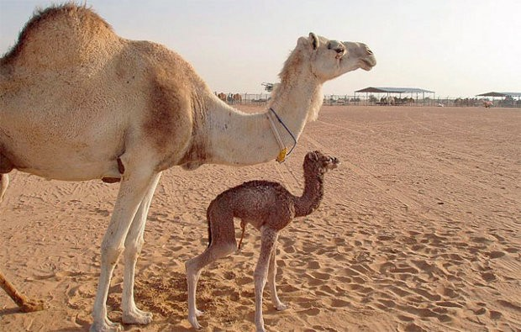
Large Scale Cloning of Camels.
World’s 1st large scale cloning of camels took place in Abu Dhabi and was conducted through somatic cell nuclear transfer – process of transferring a nucleus of a stem cell to the cytoplasm of an egg.
Hello! My name is Injaz. I was born on the 8th of April 2009
A herd of camels at a research center.
World’s 1st cloned camel with its calf.

Slide 8
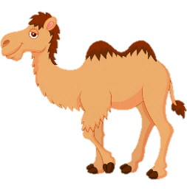

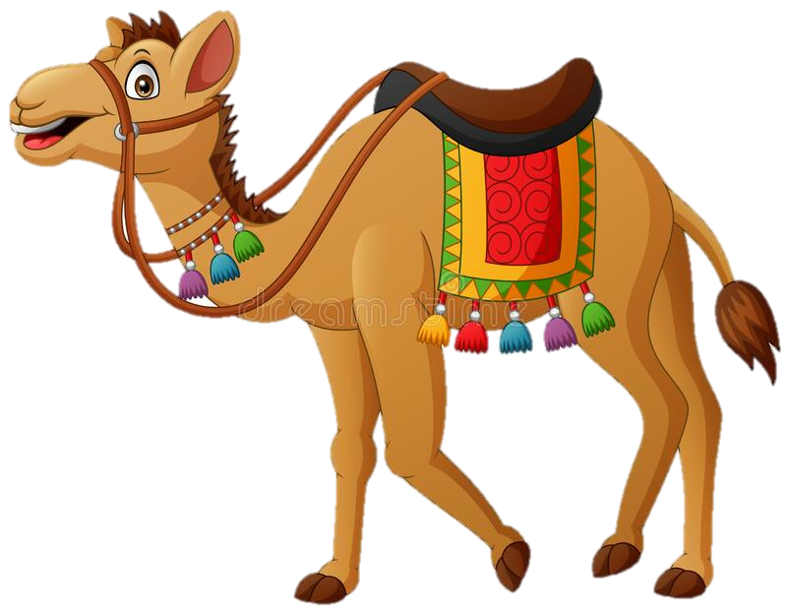
Outcome of The World’s 1st Large Scale Cloning of Camels.
Number of surrogates :
( 287 )
Pregnancy confirmations :
( 47 )
Maintained pregnancies :
( 28 )
Survived and healthy :
( 19 )
My friends are here to show you the results.
So …..what do you think ?

Slide 9
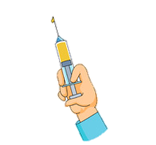
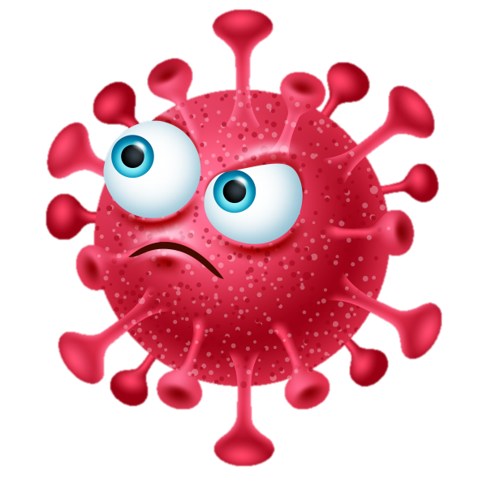
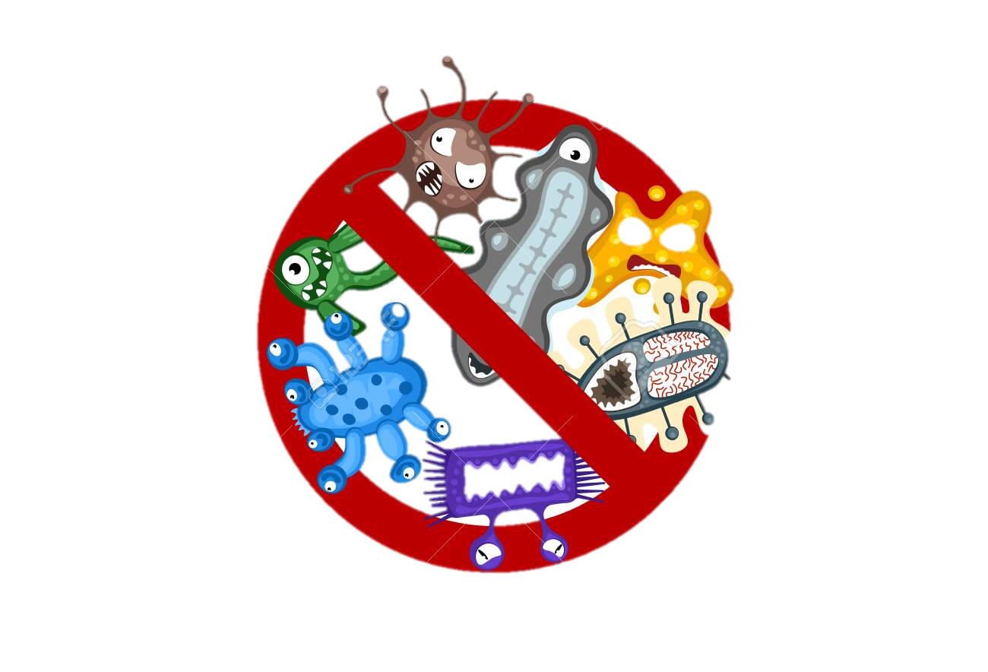
Breeding for Disease Resistance of Livestock
What is Resistant of Disease?
This schematic diagram showing the applications of immuno genomics and genome editing to produce disease resistant animals
Host immune system
Host genome
Pathogens
Application of Immunogenomics
Identification of candidate genes for disease resistance
Application of CRISPR/Cas9-based genome editing for the target gene
Disease resistant animals

Slide 10
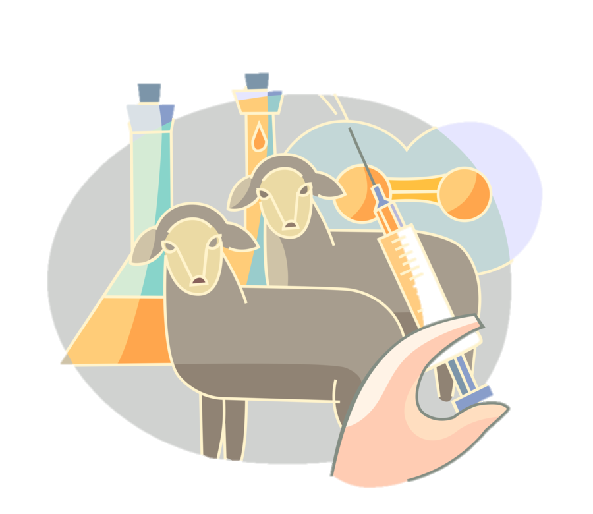
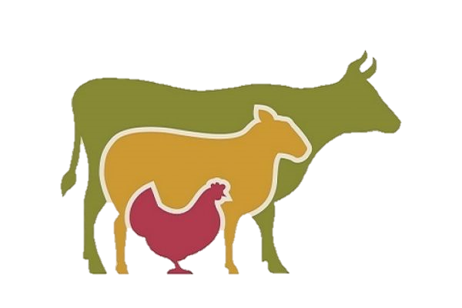
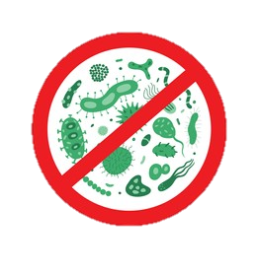
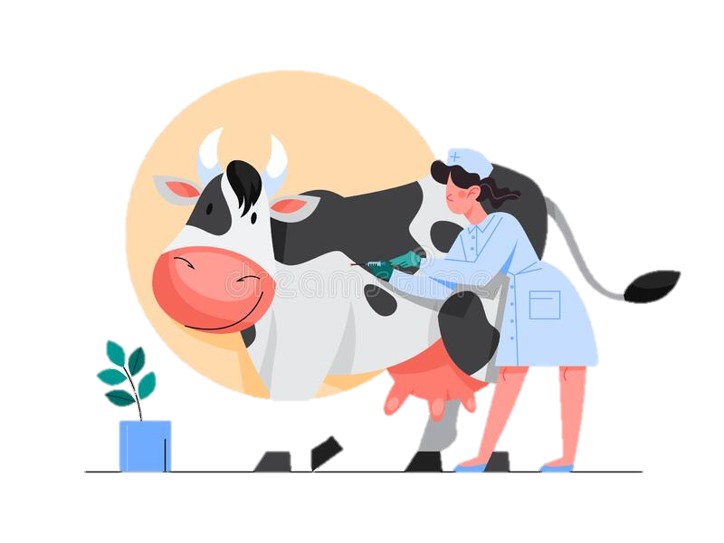
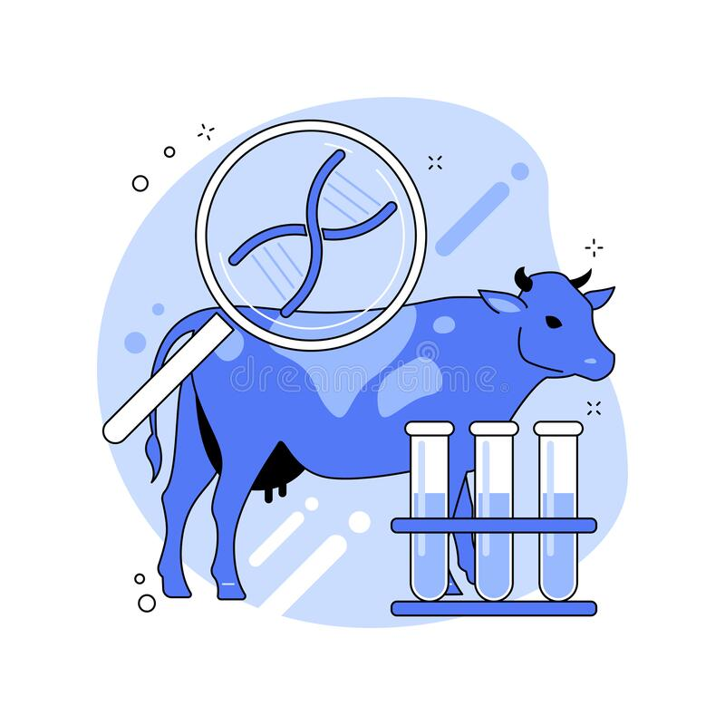
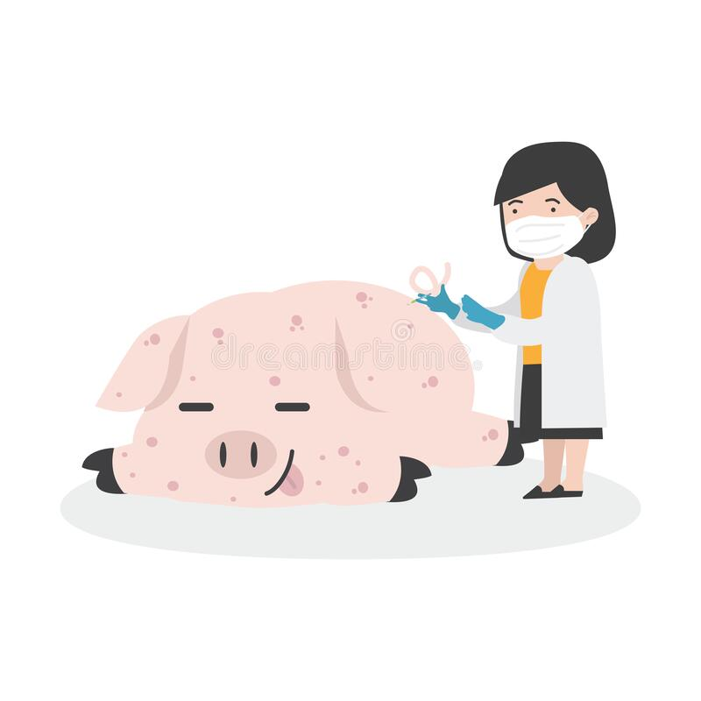
Applications of disease resistant animals.
How does the production of disease resistance animals affect agriculture ?

Slide 11
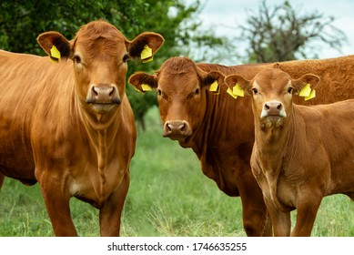
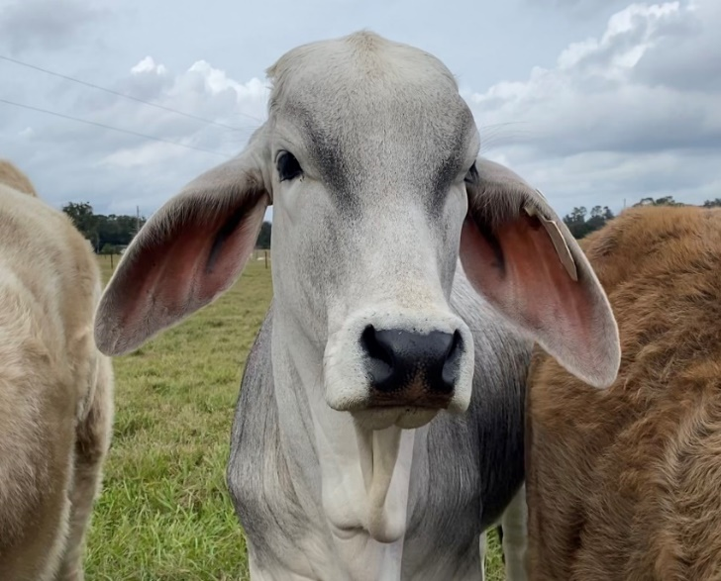

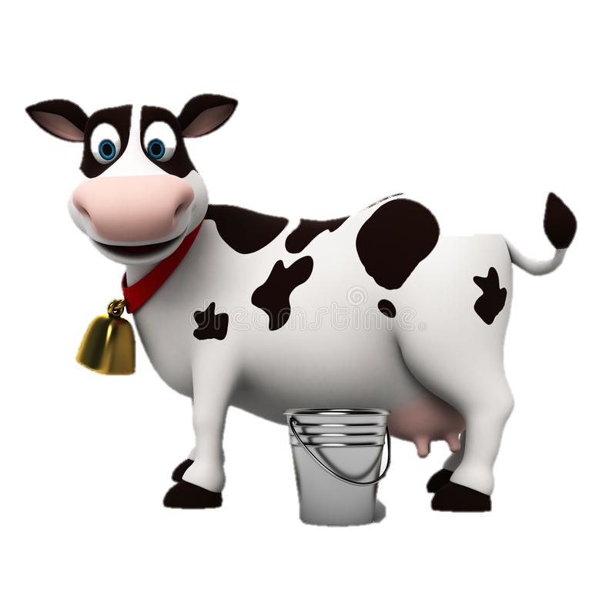
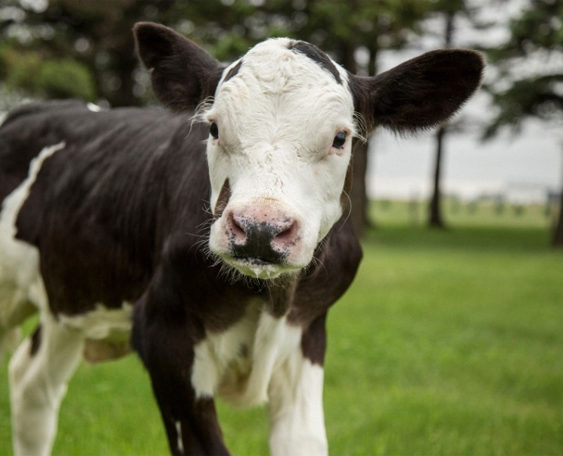
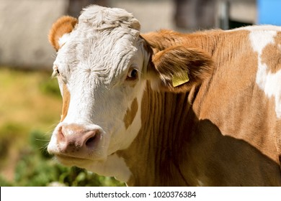
Road To Hornless Cattle Breeding
Is it possible to naturally breed hornless cattle

Slide 12
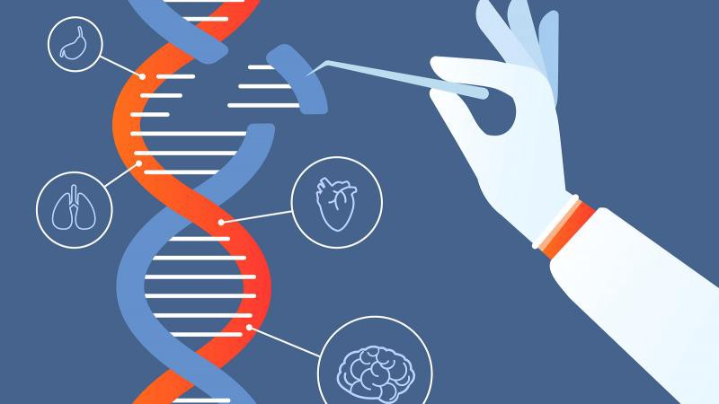
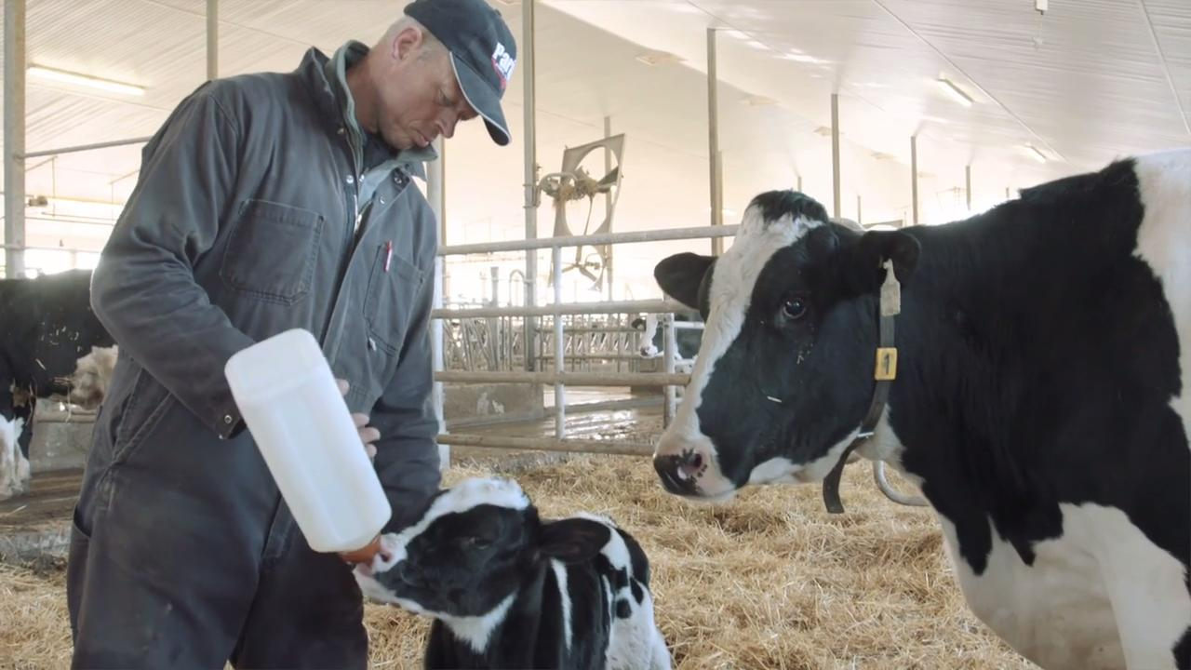
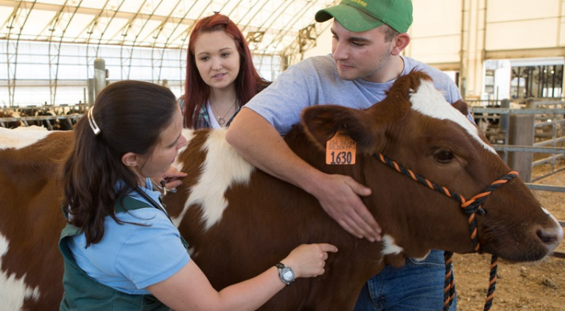
What is the Gene Editing Technology?
Cut the DNA
Remove existing DNA
Insert replacement DNA
This naturally dehorning method helps to,
Remove both harmful and expensive
method
Protect handlers
Protect other animals
Easier to handle

Slide 13
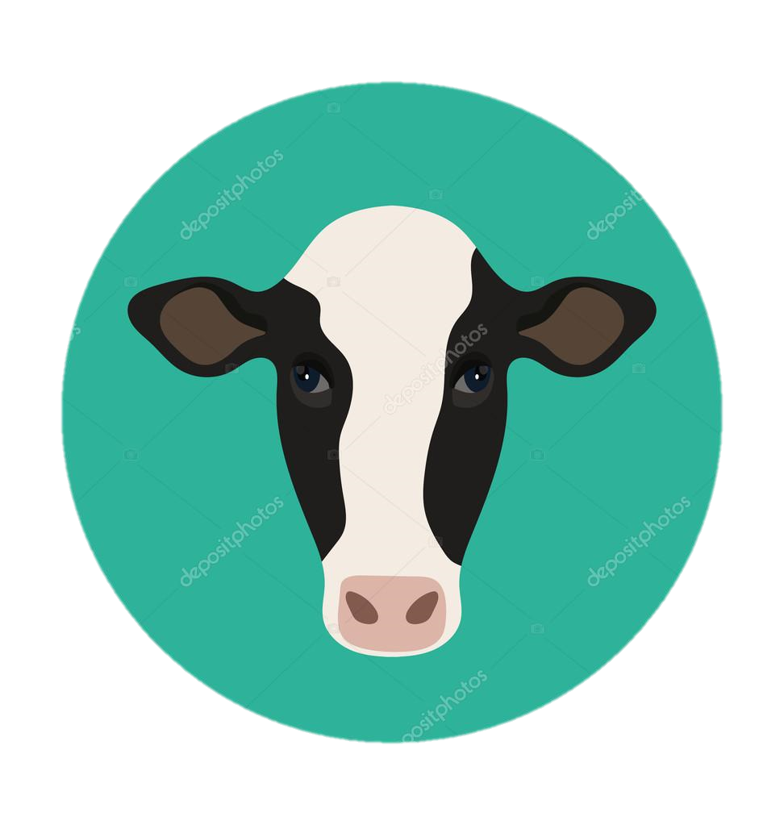
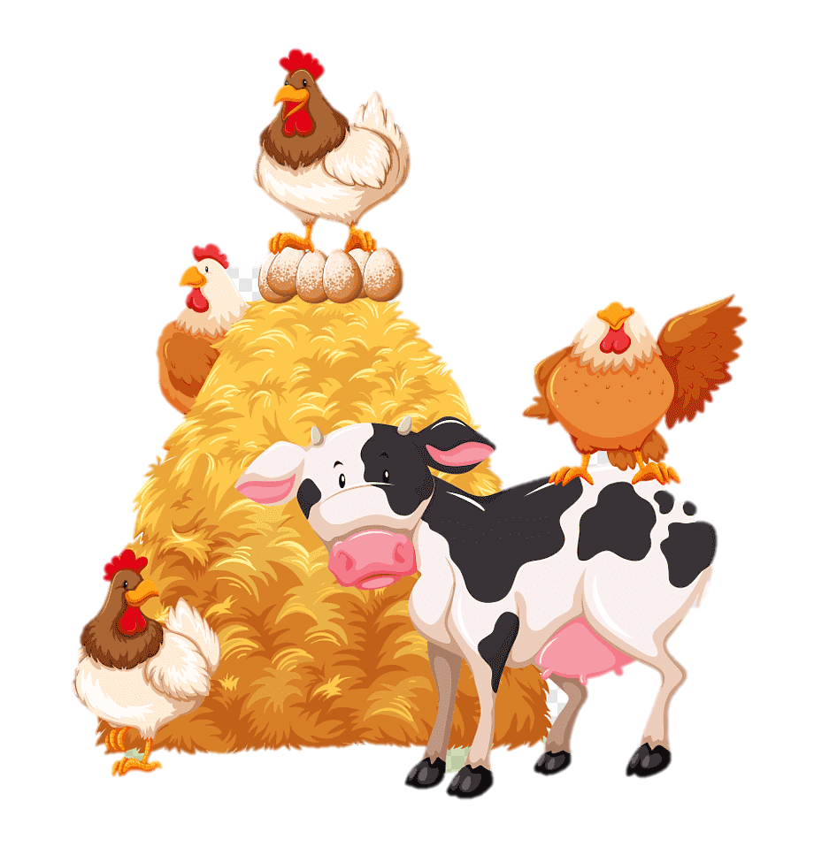
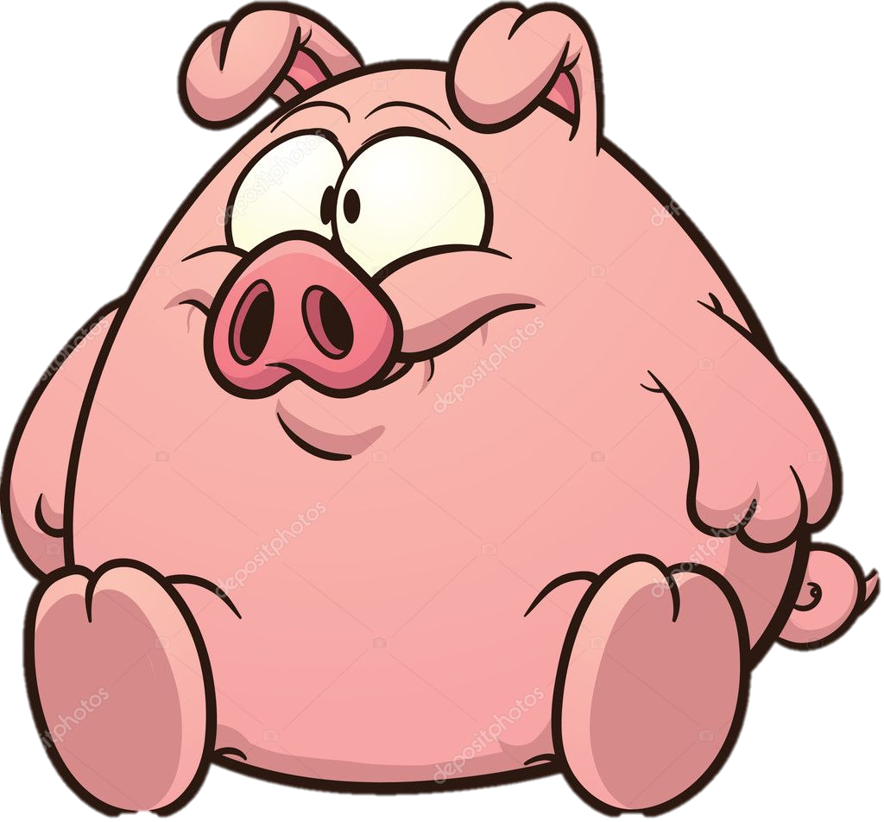
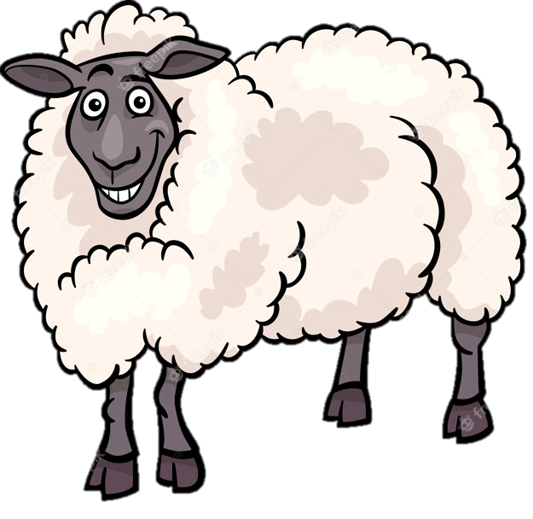
Pros of Agricultural animal Biotechnology
To create more high-yield from farm animals
Genetically modified disease resistant farm animals- Example :Prion free Cattles
To fact-finding and testing purposes

Slide 14
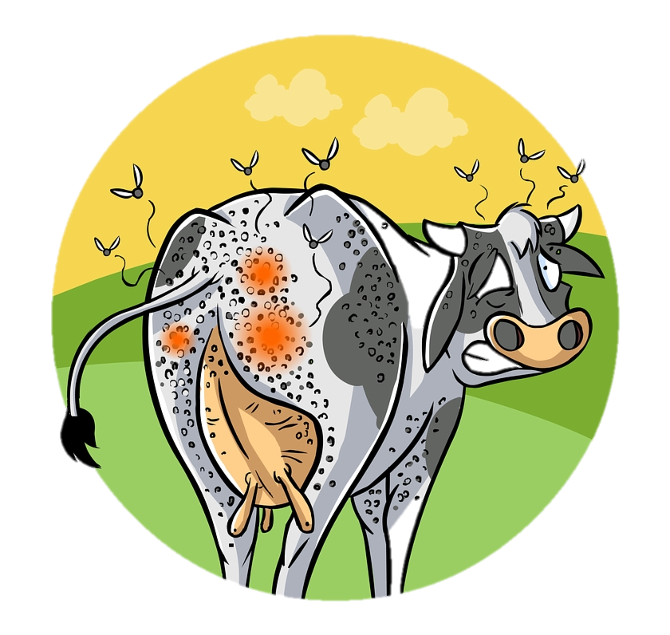
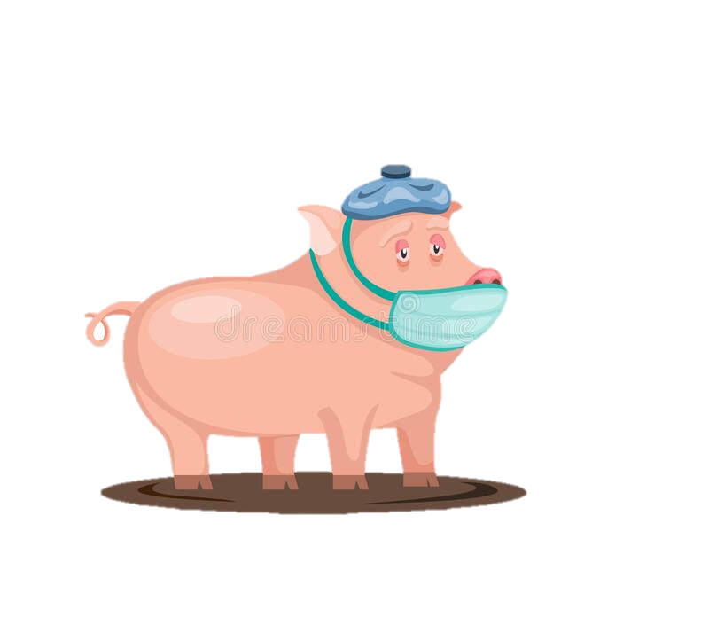
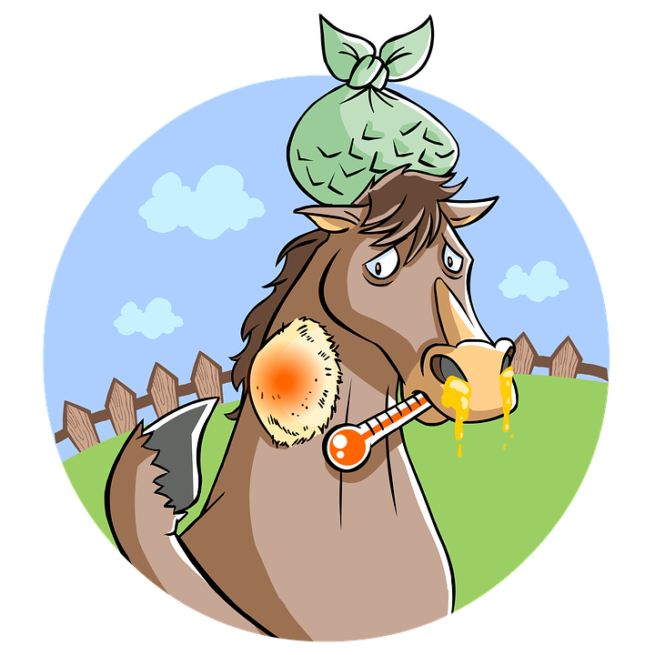
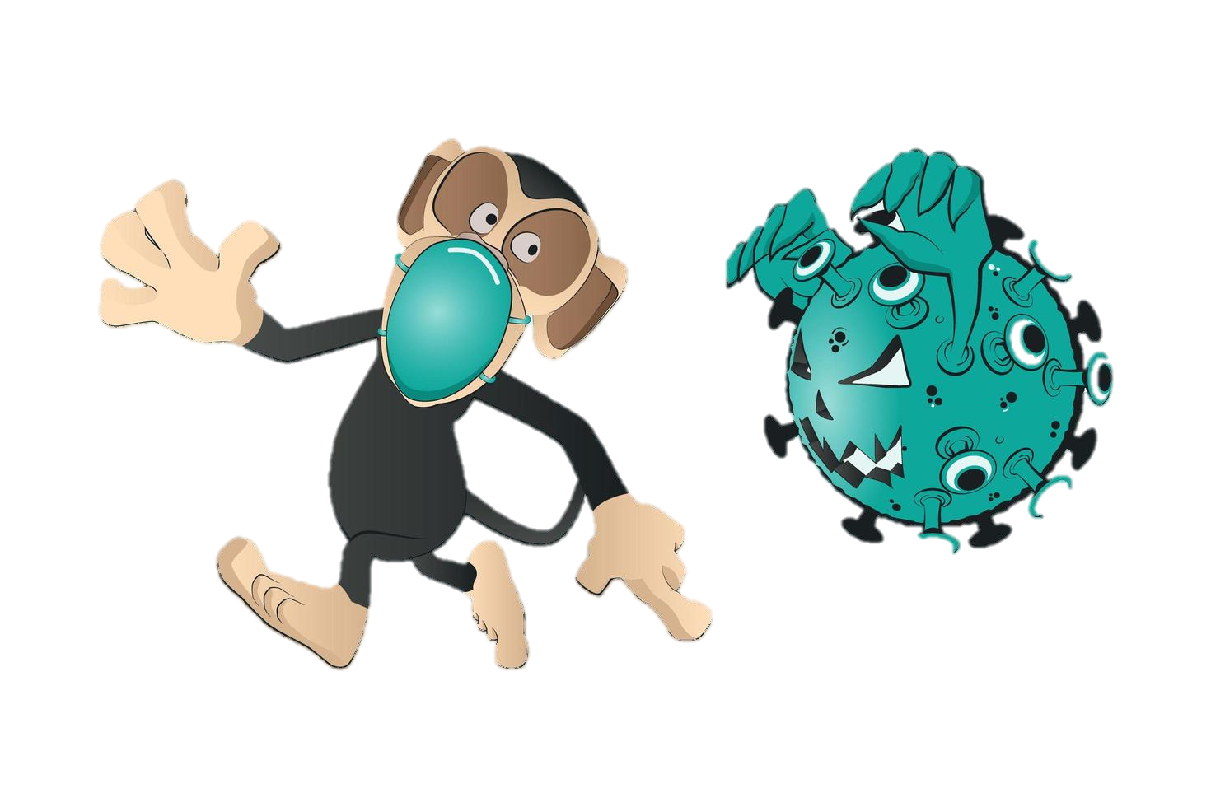
Cons of Agricultural animal Biotechnology
The risk of diseases -Example : AIDS Virus
Failure of traditional livestock farming
Negative affects on the environment

Slide 15
Conclusion
How scientists have used technologies to create transgenic animals?
Applications on disease resistant agricultural animals?
Pros and cons of agricultural animal biotechnology?

Slide 16
References
Bardsley, D. (2021, July 2). How UAE camel cloning became an industry worth millions of dirhams. The National. https://www.thenationalnews.com/uae/how-uae-camel-cloning-became-an-industry-worth-millions-of-dirhams-1.1169175
Olsson, P. O. (2021, July 12). Blastocyst formation, embryo transfer and breed. . . Scientific Reports. https://www.nature.com/articles/s41598-021-92465-9?error=cookies_not_supported&code=f60477bb-bea4-44ee-9bd9-75d0efc8d961
Stewart, A. (2021, January 12). Injaz, the world’s first cloned camel, born in Dubai, has died. WIRED Middle East. https://wired.me/science/inside-the-dubai-lab-where-the-worlds-first-cloned-camel-was-born/

Slide 17
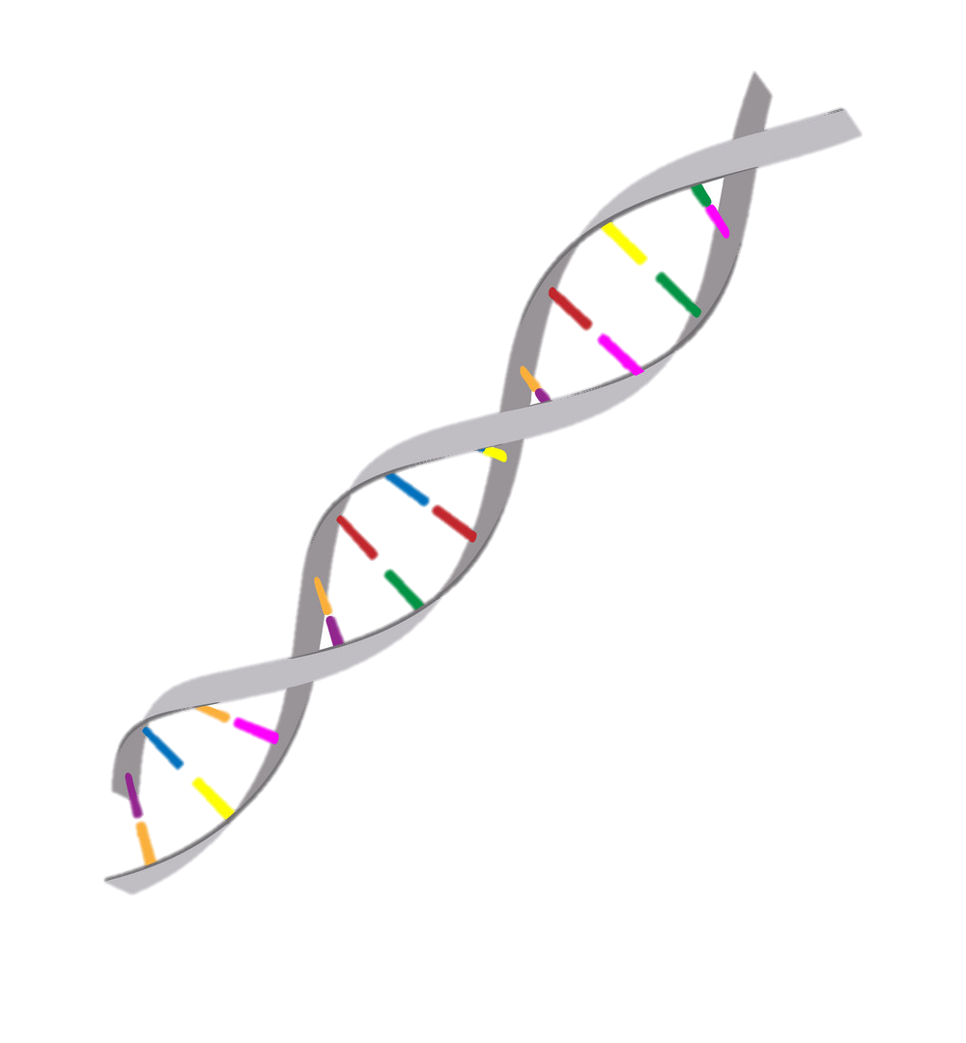







THANK YOU !

